Slide 1
Optimization of Cell Tower Distribution for Extending Drone Coverage
Ismet Celik
Namadev Narne
Rituraj Gaikawad

Slide 2
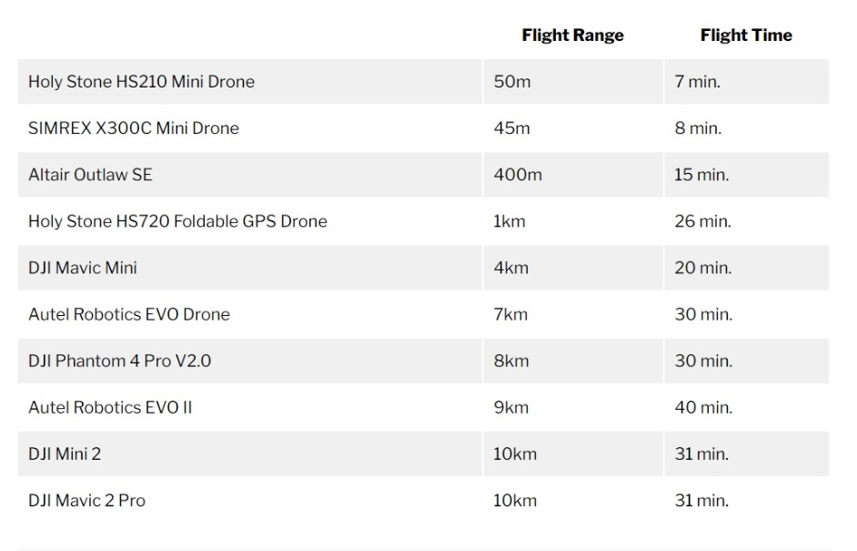
Problem Description
Currently various drones can only fly 50 meter to 10 kilometer from its remote controller without considering various factors such as obstacles, payload, weather and frequency tunning.
Cell Towers Distribution over Manhattan area to increase the flight range of the drones.
With good signal from the towers drones will be able to extend their flight range and deliver more packages.
Improving the coverage range of the cell tower also can be used for crime detection and surveillance over maximum number people.

Slide 3
Problem Significance
Drones might use by major security forces (NYPD) for crime detection and surveillance purposes over the major cities.
Many companies such as Amazon, UPS etc are considering to start package delivery model by using drones in near future.

Slide 4
Innovation
Drones need more flight range to use in the delivery and security operations, by help of our model, drones will be operated from Single Control Stations by the help of signal towers that we located.
In this approach we are considering the build a network of towers by choosing their locations and numbers over Manhattan. These towers will use for covering maximum population by doing so, we used MIXED-INTEGER LINEAR PROGRAMING model to find locations to build cell towers.

Slide 5
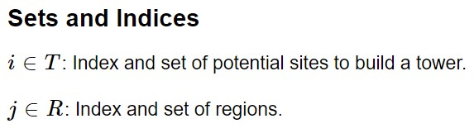
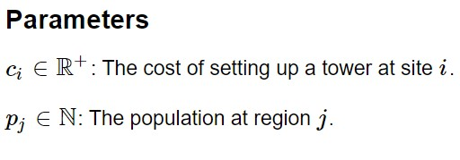
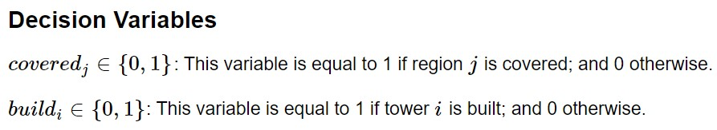
Optimization Model
Parameters to forming the model

Slide 6
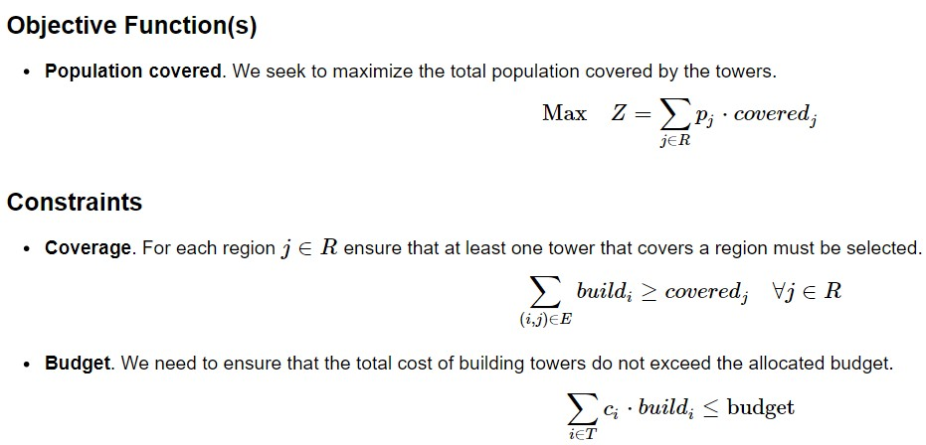
Optimization Model

Slide 7
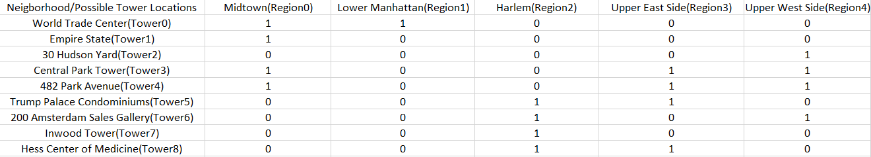
Implementation
Extracted the neighborhoods and the population of Manhattan from [2]
Budgets for building the towers are assumed.
Population and possible Tower location to cover the neighborhoods is as follows:

Slide 8
Risk
As from the result obtained from Algorithm three towers gives us the total coverage of the people, When one of the tower malfunctions the entire the operation is disrupted as there are no backup options, This will have a great effect on the efficiency of the entire system.

Slide 9

Conclusion
With this Model our Algorithm maximize the covered population and location to build the tower along with budget consideration.
We implemented our algorithm with budgets $5M, $10M, $15M and assumed the cost of $5M to construct a single tower, you can see our outputs in the pictures attached below and next slides.
Iteration 1:

Slide 10
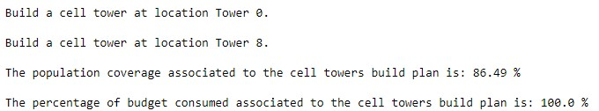
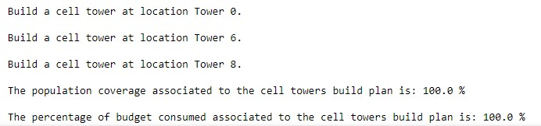
Conclusion
Iteration 2:
Iteration 3(final output):

Slide 11
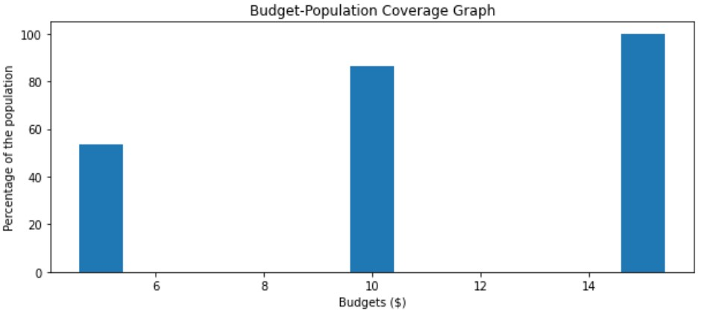
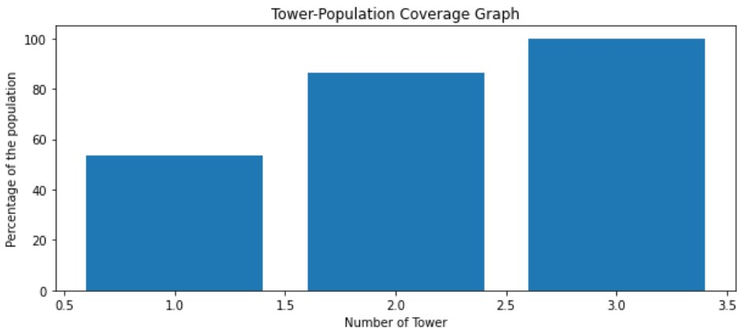
Graph of Budget vs Percentage of Population covered:
Graph of Number of Towers vs Percentage of Population covered:

Slide 12
Future Work
In our model we assumed the budget to construct a tower at a location, with increase in the budget backup towers can be designed to the faulty ones.
The proposed model can be developed using Real-Time data from various Wireless Companies for designing and using the towers
Further Improvements can be done by incorporating the constraints associated in the Drone operation.

Slide 13
Collabration
Interacted in ZOOM meetings and conference calls.

Slide 14
References
[1] “Cell Tower Coverage.” cell_tower, Gurobi Optimization, gurobi.github.io/modeling- examples/cell_tower_coverage/cell_tower.html.
[2]“Manhattan Neighborhoods by Population.” WorldAtlas, WorldAtlas, worldatlas.com/articles/manhattan-neighborhoods-by-population.html
[3] “ChargeUp.” GitHub, Ccubc, https://github.com/ccubc/ChargeUp

